Slide 1
PAPER BOATS & BUTTERFLIES
Unfolding the truth…
Learning Objectives:
To predict the subject of a novel by using clues.
To understand the use of symbolism in a novel.

Slide 2
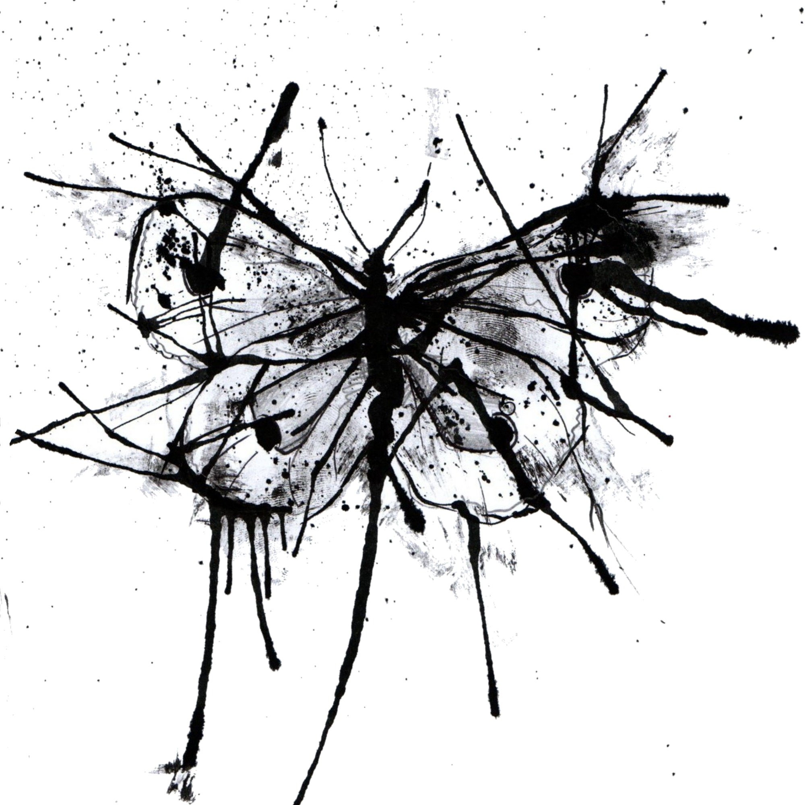
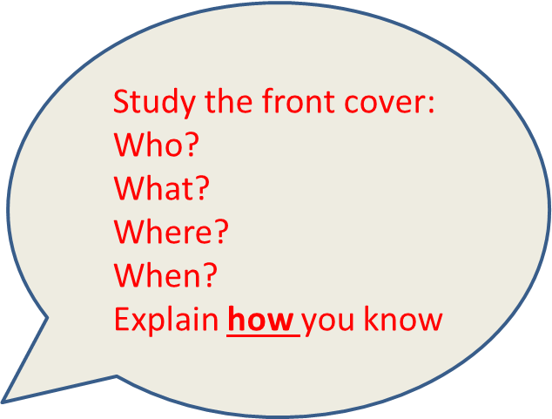
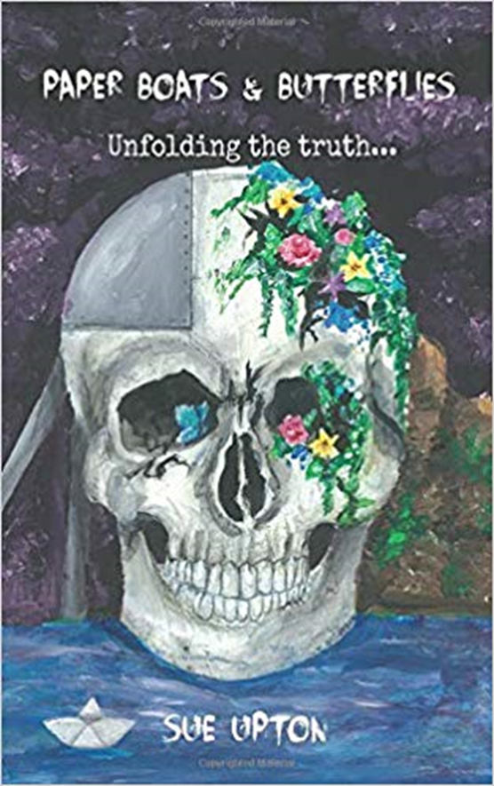
Complete the analysis sheet.

Slide 3
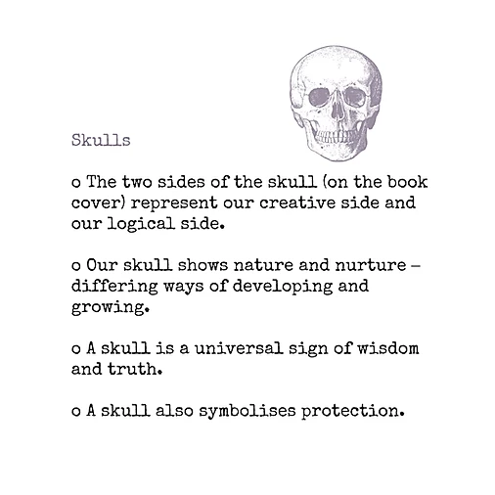
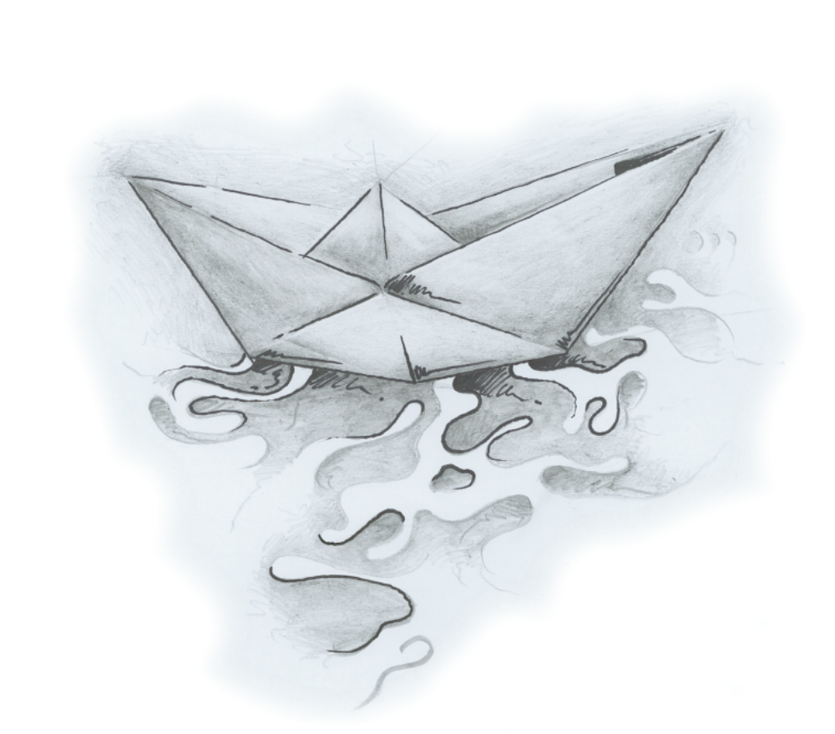
What is symbolism?
How is it used in the novel?

Slide 4
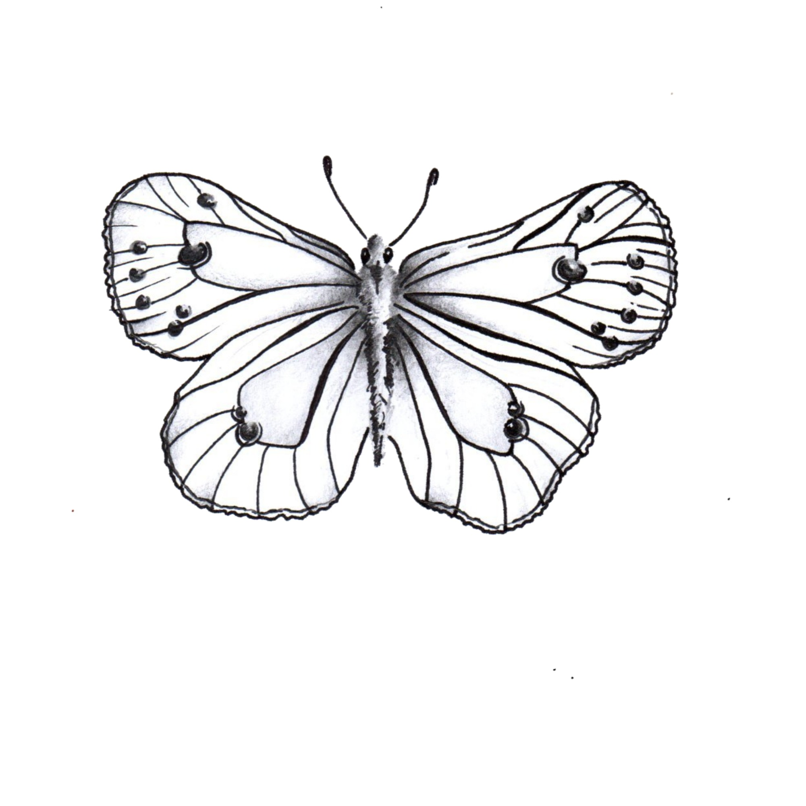
The novel is organised with 2 story lines (narratives) running parallel to each other.
One is symbolised by a paper boat and the other by a butterfly.
Discuss with a partner what you think these two images might symbolise- share with the class.

Slide 5
Use the Mind Map sheet with the 2 images.
Write down anything you already know about paper or boats
Now write down anything you already know about butterflies e.g. they start as an egg and then a caterpillar.
Then add information from the next slide.

Slide 6
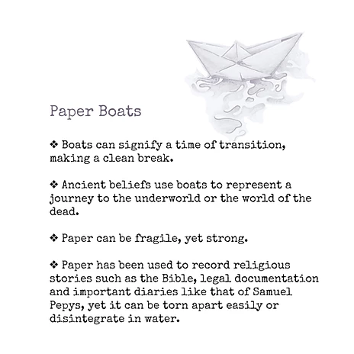
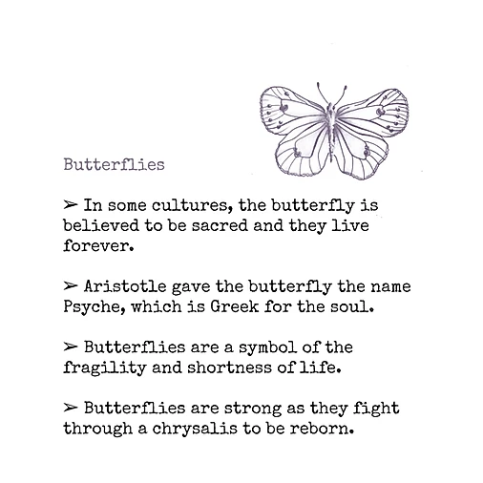
Choose information here to add to your two pages

Slide 7
What have you learned about symbolism?
Write 3 bullet points

Slide 8
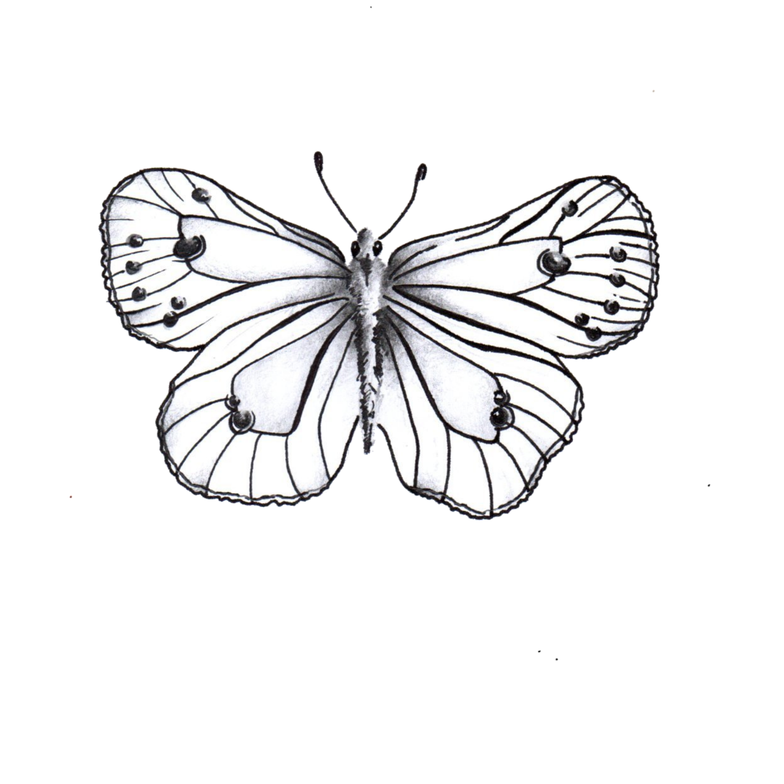
Have fun with books
Extra stuff for fun!
Design a book cover for Paper Boats and Butterflies: Unfolding
the Truth.
Design a book cover for your favourite book. Write your own blurb.
Write down questions you would ask Sue Upton, the author of Paper Boats and Butterflies.
Design and make a book mark.
Make a paper boat or an origami butterfly.
Write your own story borrowing the title – Unfolding the Truth.

